Slide 1

CMP1101:
MOS LOGIC

Slide 2
DIGITAL LOGIC GATES
Digital logic gates are electronic devices that make logic decisions based on different combinations of digital signals as the inputs.
They are the basic building block of electronic circuits and microprocessor-based systems.
Digital logic gates may have more than 1 input but they generally have only 1 output.
Individual logic gates can be connected together to form combinational or sequential circuits or even larger logic gate functions.
Standard commercially available digital logic gates are available in two basic forms
Transistor-Transistor Logic (TTL)
Complementary Metal-Oxide Silicon (CMOS)
TTL or CMOS refers to the technology used to manufacture integrated circuits (ICs).

Slide 3
Logic Gates Contd.
Generally, TTL ICs use NPN or PNP Bipolar Junction Transistors (BJTs) while CMOS ICs are constructed using MOSFETs or JFETs for both their input and output circuitry.
Simple logic gates however can be constructed using diodes, resistors and transistors.
Resistor-Transistor Logic (RTL) gates
Diode-Transistor Logic (DTL) gates
Emitter-Coupled Logic (ECL) gates
RTL, DTL and ECL are not as common as the CMOS family

Slide 4
Logic Gates contd.
ICs can be grouped together into families according to the number of transistors or gates that they contain.
As an example, an AND gate can contain only a few transistors while a more complex microprocessor may contain thousands of individual transistor gates.
Moore’s Law – predicts that the number of transistors and resistors on a single chip will double every 18 months.
This prediction however is failing with newer and faster technological advancements.

Slide 5
Logic Gates contd.
Examples of classifications of ICs include
Small Scale Integration (SSI) with up to 10 transistors or a few gates within a single package such as AND, OR and NOT gates.
Medium Scale Integration (MSI) with between 10 – 100 transistors or tens of gates within a single package to perform digital operations such as adders, decoders, counters, etc.
Large Scale Integration (LSI) with between 100 – 1,000 transistors or hundreds of gates to perform functions such as arithmetic.
Very-Large Scale Integration (VLSI) with between 1,000 – 10,000 or thousands of gates and perform computational operations such as processors, large memory arrays and programmable logic devices.
Ultra-Large Scale Integration (ULSI) with more than 1 million transistors and are used in computer CPUs, GPUs, video processors, etc.

Slide 6
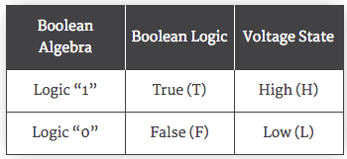
Logic Gates contd.
In digital logic design, only two states are allowed and referred to as:
Logic “1” or Logic “0”
High or Low
True or False
Basic digital logic gates perform operations of AND, OR and NOT on binary numbers.
The relationship between the various digital states can be summarized as below:

Slide 7
Logic Gates contd.
Most digital logic gates and logic systems use “Positive Logic” in which
Logic “0” or Low or False is represented by a zero voltage or 0V or ground
Logic “1” or High or True is represented by a higher voltage
The switching from one logic level to another is made as quickly as possible to prevent faulty operation of the logic circuit.
The reverse is true for the “Negative Logic”.

Slide 8
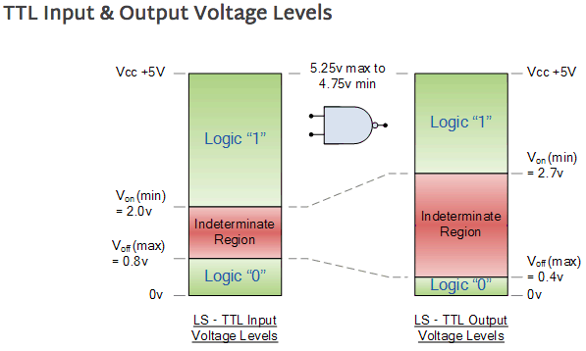
TTL
In standard TTL ICs, there is a predefined voltage range for the input and output voltage levels which define exactly what makes a Logic “1” or a Logic “0”

Slide 9
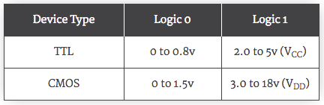
CMOS
In CMOS technology, a
Logic “0” is any input below 1.5V while
Logic “1” is any input between 3.0V – 18.0V.
As compared to TTLs, the chart below summarizes the logic states.
The main shortcoming of TTL gate series is that the logic gates are based on BJTs whose transistors are current operated devices and consume large amounts of power from a fixed +5V power supply.
In addition, TTL transistors have a limited operating speed when switching from an “OFF” state to an “ON” state, and vice versa.

Slide 10
CMOS contd.
To overcome the TTL limitations, CMOS logic uses FETs .
CMOS gates use both p-channel and n-channel MOSFETs as the input devices.
With no switching, the power consumption of CMOS gates is almost zero and this makes them ideal for use in low-power battery circuits.
However, CMOS devices are static sensitive thus appropriate precautions must be taken when handling such devices.
Working on grounded work benches
Wearing anti-static wrist bands, etc.

Slide 11
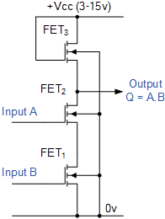
Example: CMOS NAND Gate
This CMOS gate example contains 3 N-channel MOSFETs
2 for the input
1 for the output
When both inputs A and B are at logic “0”
FET₁ and FET₂ are both switched OFF and thus effectively open circuits.
The output is thus a logic “1” supplied at the output from the source of FET₃.

Slide 12
CMOS NAND Gate contd.
When 1 or both of the inputs are at logic “1”.
Current flows through the corresponding FET giving an output state at Q equivalent to logic “0”
This happens since the short circuit in the FET that is in the ON state effectively transfers the 0V from the grounding to which all input FETs are connected.
The combined effect is the resultant NAND gate.
CMOS logic designs generally present great switching speeds, lower power consumption and improved propagation delays.
Like TTLs, CMOS logic takes advantage of the fact that both P-channel and N-channel devices can be fabricated together on the same substrate material to form various logic functions.

